Slide 1

Analysis Report
Park, Pablo Chanwoo

Slide 2
Project Objectives
Milestones Skill Set Data Scientist Strategic Analyst
■ Primary objective
In [1]: Prove whether the hypothesis “ Soju sales are increasing and cannibalizing the beer category” is acceptable.
Out [1]: How is the relationship between demand for Soju and beer?
■ Secondary objective
In [2]: Find opportunities to gain category share and increase beer incidents.
Out [2]: What are the features that affect beer demand?

Slide 3
The Findings
The relationship between Soju and beer seem to be more of a complimentary than a substitute goods.

Slide 4
The Findings
2nd findings…

Slide 5

DataSet
Given 16,635 rows of daily summary of transaction from 147 bars
Basic information |  |  | Volumes |  |  | Units |  |  | Revenue |  |  |  |  |  |  | Order counts |  |  |  | Derivatives
Bar ID | Date | Bar Segmentation | Beer Draught Volume (L) | Beer Packaged Volume (L) | Total Volume (L) | Beer Units | Spirits Units | Soju Units | Total Revenue | Beer Revenue | Spirits Revenue | Soju Revenue | Wine Revenue | Food Revenue | Non Alcoholic Revenue | # Beer Orders | # Beer & Food Orders | # Soju & Beer Orders | # Soju & Food Orders | Avg. Check Size | Soju Price
Bar 1 | 2017-07-01 | Food,Spirits | 9.3 | 6.16 | 15.46 | 22 | 68 | 12 | 887,100 | 124,500 | 278,000 | 54,000 | - | 461,100 | 23,500 | 14 | 14 | 1 | 7 | 26,882 | 4,500
Bar 1 | 2017-07-02 | Food,Spirits | 21.3 | 2.5 | 23.8 | 16 | 63 | 4 | 745,800 | 167,500 | 256,000 | 18,000 | - | 298,300 | 24,000 | 7 | 7 | 1 | 2 | 46,613 | 4,500
Bar 1 | 2017-07-03 | Food,Spirits | 9.3 | 2.5 | 11.8 | 12 | 57 | 5 | 575,100 | 87,000 | 237,000 | 27,000 | - | 234,100 | 10,000 | 7 | 7 | 2 | 4 | 26,141 | 5,625
… | … | … | … | … | … | … | … | … | … | … | … | … | … | … | … | … | … | … | … | …
… | … | … | … | … | … | … | … | … | … | … | … | … | … | … | … | … | … | … | … | …
Bar 147 | 2017-12-30 | Food | 44.9 | 1.98 | 46.88 | 91 | 10 | - | 1,577,712 | 318,639 | 36,360 | - | - | 1,206,445
Bar 147 | 2017-12-31 | Food | 37.2 | 7.92 | 45.12
□ Dataset
Size: 16,635 x 22
Period: July 2017 ~ December 2017
Source: POS from 147 bar
Types: identifiable information,
volumes sold in liter (limited to beer),
units sold (beer and spirits(soju) category only),
revenue for a day (Food + beverage categories),
order counts (limited to specific conditions),
and derivatives from above variables
□ Able to…
Understand basic information about the bar
Track sales volume of beverage by category
Approximate price given revenue and units
□ Unable to…
Track proportion of beer order from total
Identify items categorized as spirits (What else but soju?)
Identify items ordered together

Slide 6
DataSet
Given 16,635 rows of daily summary of transaction from 147 bars
Basic information |  |  | Volumes |  |  | Units |  |  | Revenue |  |  |  |  |  |  | Order counts |  |  |  | Derivatives
Bar ID | Date | Bar Segmentation | Beer Draught Volume (L) | Beer Packaged Volume (L) | Total Volume (L) | Beer Units | Spirits Units | Soju Units | Total Revenue | Beer Revenue | Spirits Revenue | Soju Revenue | Wine Revenue | Food Revenue | Non Alcoholic Revenue | # Beer Orders | # Beer & Food Orders | # Soju & Beer Orders | # Soju & Food Orders | Avg. Check Size | Soju Price
Bar 1 | 2017-07-01 | Food,Spirits | 9.3 | 6.16 | 15.46 | 22 | 68 | 12 | 887,100 | 124,500 | 278,000 | 54,000 | - | 461,100 | 23,500 | 14 | 14 | 1 | 7 | 26,882 | 4,500
Bar 1 | 2017-07-02 | Food,Spirits | 21.3 | 2.5 | 23.8 | 16 | 63 | 4 | 745,800 | 167,500 | 256,000 | 18,000 | - | 298,300 | 24,000 | 7 | 7 | 1 | 2 | 46,613 | 4,500
Bar 1 | 2017-07-03 | Food,Spirits | 9.3 | 2.5 | 11.8 | 12 | 57 | 5 | 575,100 | 87,000 | 237,000 | 27,000 | - | 234,100 | 10,000 | 7 | 7 | 2 | 4 | 26,141 | 5,625
… | … | … | … | … | … | … | … | … | … | … | … | … | … | … | … | … | … | … | … | …
… | … | … | … | … | … | … | … | … | … | … | … | … | … | … | … | … | … | … | … | …
Bar 147 | 2017-12-30 | Food | 44.9 | 1.98 | 46.88 | 91 | 10 | - | 1,577,712 | 318,639 | 36,360 | - | - | 1,206,445
Bar 147 | 2017-12-31 | Food | 37.2 | 7.92 | 45.12
Regression to study coefficient
CART ensemble to test feature importance
□ Dataset
Size: 16,635 x 22
Period: July 2017 ~ December 2017
Source: POS from 147 bar
Types: identifiable information,
volumes sold in liter (limited to beer),
units sold (beer and spirits(soju) category only),
revenue for a day (Food + beverage categories),
order counts (limited to specific conditions),
and derivatives from above variables
□ Able to…
Understand basic information about the bar
Track sales volume of beverage by category
Approximate price given revenue and units
□ Unable to…
Track proportion of beer order from total
Identify items categorized as spirits (What else but soju?)
Identify items ordered together

Slide 7
DataSet
Given 16,635 rows of daily summary of transaction from 147 bars
Why units?
Basic information |  |  | Volumes |  |  | Units |  |  | Revenue |  |  |  |  |  |  | Order counts |  |  |  | Derivatives
Bar ID | Date | Bar Segmentation | Beer Draught Volume (L) | Beer Packaged Volume (L) | Total Volume (L) | Beer Units | Spirits Units | Soju Units | Total Revenue | Beer Revenue | Spirits Revenue | Soju Revenue | Wine Revenue | Food Revenue | Non Alcoholic Revenue | # Beer Orders | # Beer & Food Orders | # Soju & Beer Orders | # Soju & Food Orders | Avg. Check Size | Soju Price
Bar 1 | 2017-07-01 | Food,Spirits | 9.3 | 6.16 | 15.46 | 22 | 68 | 12 | 887,100 | 124,500 | 278,000 | 54,000 | - | 461,100 | 23,500 | 14 | 14 | 1 | 7 | 26,882 | 4,500
Bar 1 | 2017-07-02 | Food,Spirits | 21.3 | 2.5 | 23.8 | 16 | 63 | 4 | 745,800 | 167,500 | 256,000 | 18,000 | - | 298,300 | 24,000 | 7 | 7 | 1 | 2 | 46,613 | 4,500
Bar 1 | 2017-07-03 | Food,Spirits | 9.3 | 2.5 | 11.8 | 12 | 57 | 5 | 575,100 | 87,000 | 237,000 | 27,000 | - | 234,100 | 10,000 | 7 | 7 | 2 | 4 | 26,141 | 5,625
… | … | … | … | … | … | … | … | … | … | … | … | … | … | … | … | … | … | … | … | …
… | … | … | … | … | … | … | … | … | … | … | … | … | … | … | … | … | … | … | … | …
Bar 147 | 2017-12-30 | Food | 44.9 | 1.98 | 46.88 | 91 | 10 | - | 1,577,712 | 318,639 | 36,360 | - | - | 1,206,445
Bar 147 | 2017-12-31 | Food | 37.2 | 7.92 | 45.12
Regression to study coefficient
CART ensemble to test feature importance
With “Beer Units” as “y”,
and “Soju Units” as one of “X” variables
□ Dataset
Size: 16,635 x 22
Period: July 2017 ~ December 2017
Source: POS from 147 bar
Types: identifiable information,
volumes sold in liter (limited to beer),
units sold (beer and spirits(soju) category only),
revenue for a day (Food + beverage categories),
order counts (limited to specific conditions),
and derivatives from above variables
□ Able to…
Understand basic information about the bar
Track sales volume of beverage by category
Approximate price given revenue and units
□ Unable to…
Track proportion of beer order from total
Identify items categorized as spirits (What else but soju?)
Identify items ordered together

Slide 8
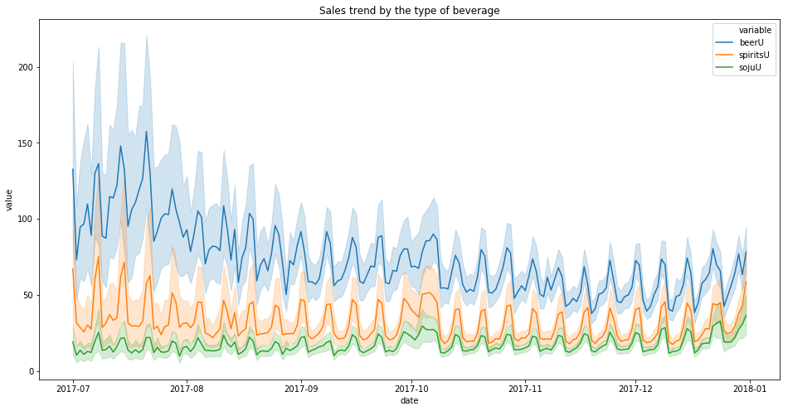
Explanatory Data Analysis
Beer demand is showing a downward slope, while others remain still.
□ Dataset
Size: 16,635 x 22
Period: July 2017 ~ December 2017
Source: POS from 147 bar
Types: identifiable information,
volumes sold in liter (limited to beer),
units sold (beer and spirits(soju) category only),
revenue for a day (Food + beverage categories),
order counts (limited to specific conditions),
and derivatives from above variables
 | mean | std
July | 109.949657 | 127.784307
August | 80.825762 | 95.144610
September | 70.827905 | 75.716210
October | 65.074388 | 71.730805
November | 54.495392 | 58.723028
December | 58.706543 | 62.453384

Slide 9
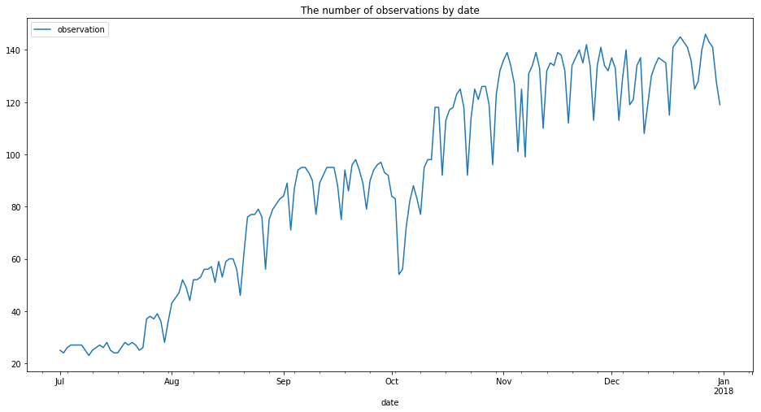
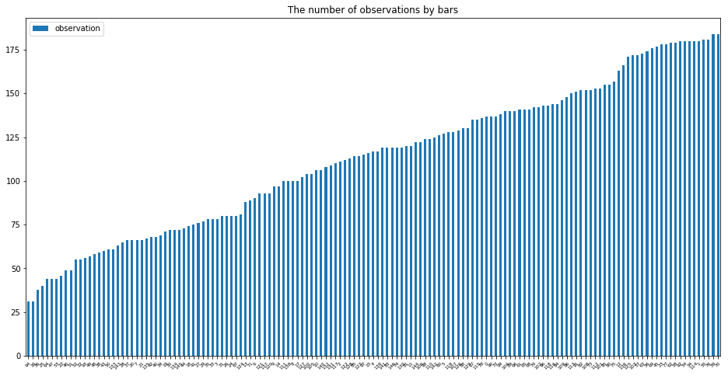
Explanatory Data Analysis
The data is not complete by date, and by bars, as there seem to be irregular patterns in missing data.

Slide 10
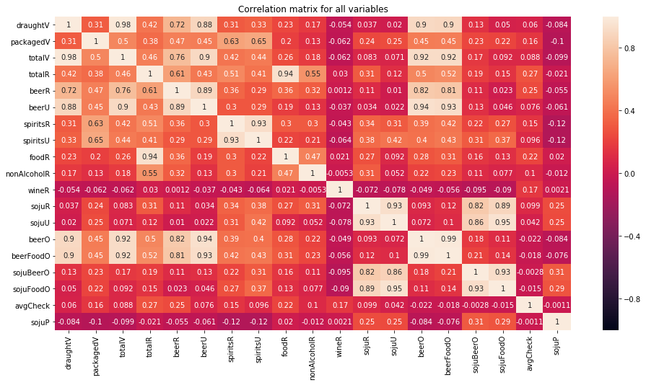
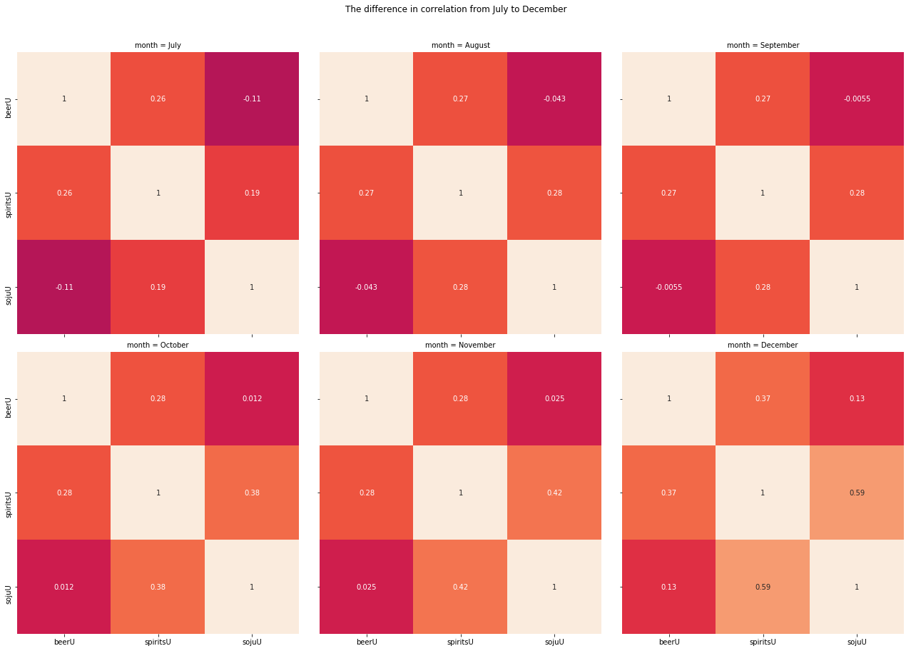
Explanatory Data Analysis
Correlations

Slide 11
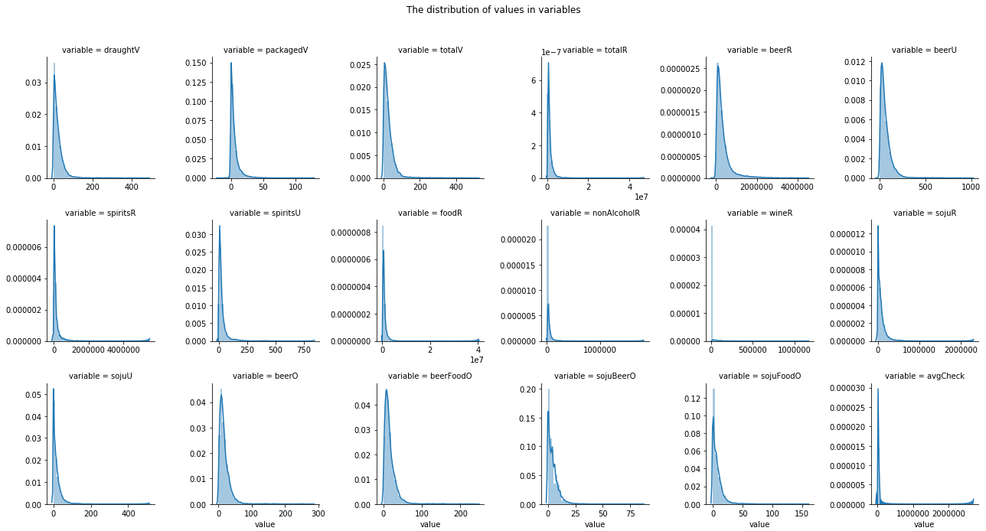
Explanatory Data Analysis
Distributions

Slide 12


Preprocessing
Zero values referring to “we do not sell” do not tell information about the relationship, while zero values referring to “we can not sell” do tell something about its relationship with other items
Definition: bar with zero sales of soju throughout the observation do not sell soju

Slide 13
Preprocessing
There are observations difficult to explain given data. They may are right and can be explained with additional features, but it is inappropriate given dataset and mislead. (They cannot have beers selling at over $40 when in average it sells under $5)

Slide 14
Preprocessing
For the purpose of regression models, I want to avoid right-skewed dataset. Log transform to fit the dataset for the appropriate model.
Also excluded negative figures (impossible values)

Slide 15
Analysis
Bagging & Ridge

Slide 16
Analysis
Random Forest

Slide 17
Conclusion
No evidence that they are cannibalizing one another

Slide 18
Limitation
Too short time period, and little consideration on seasonality. I cannot argue that my conclusion is right!

Slide 19
What else could I do to create value with it
Using traits of bar to cluster and look for differences in them

Slide 20
Means of application

